Slide 1
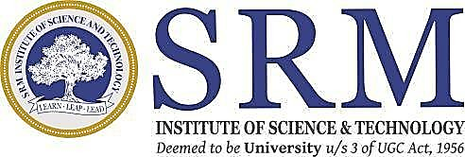
Aquaculture Monitoring System
By
V. Leela Kumar (RA2011053010030)
V. Balaji (RA2011053010014)
P. Tejesh (RA2011053010044)

Slide 2
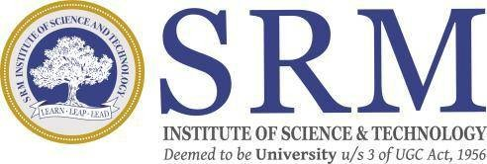
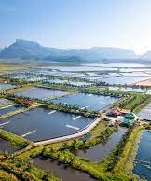
Introduction Aquaculture is a vital industry that plays a crucial role in meeting the growing demand for aquatic products as the world's population continues to increase. To improve the management of aquatic environments, promote the growth and health of aquatic creatures, and enhance the overall effectiveness of aquaculture operations. Aquaculture meets the demand for Aquatic products. Machine Learning and IoT can optimize operations. This study examines their applications and Potential for future research.

Slide 3
Problem, Motivation, Objective:
Changes in water quality determined by climate and its fickleness, for changes in climate directly or indirectly result in changes in the aquatic environment. So, we need to monitor and control the changes in parameters which leads to less yield.
our proposed system keeps track of all the internal and external environmental factors in the farming, and then apply self-learning so that, in the future, fish farming will be freed from the need of manual operations. This work will contribute remote monitoring framework through IoT to screen water quality in ponds.
The goal of this project is to design and execute a distributed system for aquaculture water quality care through remote observing of turbidity, temperature and humidity.

Slide 4
Literature review paper [1] creates a system to monitor and regulate various parameters of fresh water that are helpful in pearl farming. Maintaining the appropriate conditions would help in increasing the yield. The parameters in the freshwater are regulated by a microcontroller using actuators. They have used the data analytics approach in the proposed system. They used sensors and actuators for monitoring and maintaining a habitable underwater environment. Paper[2] Digital solutions like agricultural management systems and robotics/AI can improve farm efficiency and decision-making. Successful implementation of these technologies requires training and education for farmers. Sustainable, data-driven agricultural practices are needed to address modern food production challenges. "Agriculture 5.0" is a key agenda for major farm equipment manufacturers.

Slide 5
Literature review
IoT-based system presented in paper [3] offers real-time monitoring, data storage, analysis, forecast, and automation for sustainable fish farming and traceability.
Nagib et al. [4] developed an aquaculture monitoring system for catfish farming based on atmega328p and various sensors for measuring turbidity, pH, and water quality.
Paper [5] presents an IoT-based system for sustainable and efficient fish farming with real-time monitoring and analysis of water quality and environmental parameters through integrated sensors.

Slide 6
Methodology
STEP 1
STEP 2
STEP 3
Monitoring Values of various parameters
Controlling Controls of various Actuators
Prediction
Predict appropriate parameters

Slide 7
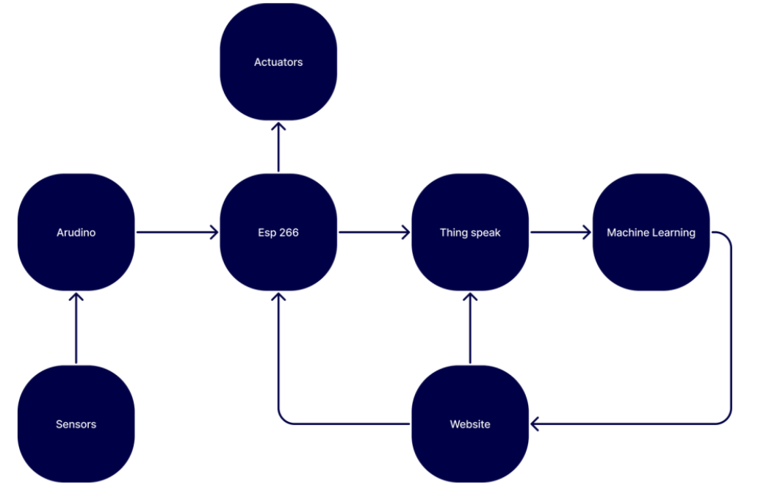
High level overview

Slide 8
Deliverables with timeline
Review 2:
Software implementation
Review 3:
Project Setup

Slide 9
Next Steps
to be implemented
Deploy sensors in an actual aquaculture farm to collect data Process the data
Train the models
Predict with help of data Implement actuators
Complete the website to control and monitor the complete system

Slide 10
References
[1] M. Singh, K. S. Sahoo and A. Nayyar, "Sustainable IoT Solution for Freshwater Aquaculture Management," in IEEE Sensors Journal, vol. 22, no. 16, pp. 16563-16572, 15 Aug.15, 2022, doi: 10.1109/JSEN.2022.3188639.
[2]V. Saiz-Rubio and F. Rovira-Más, “From smart farming towards agriculture 5.0: A review on crop data management,” Agronomy, vol. 10, no. 2, p. 207, Feb. 2020.
[3]G. Gao, K. Xiao, and M. Chen, “An intelligent IoT-based control and traceability system to forecast and maintain water quality in fresh- water fish farms,” Comput. Electron.
Agriculture., vol. 166, Nov. 2019, Art. no. 105013.

Slide 11
References
[4]N. Mahfuz and S. M. Al-Mayeed, “Smart monitoring and controlling system for aquaculture of Bangladesh to enhance robust operation,” in Proc. IEEE Region 10 Symp. (TENSYMP), Jun.
2020, pp. 1128–1133.
[5]Gao, G., Xiao, K., & Chen, M. (2019). An intelligent IoT-based control and traceability system to forecast and maintain water quality in freshwater fish farms. Computers and Electronics in Agriculture, 166, 105013. https://doi.org/10.1016/j.compag.2019.105013

